Slide 1
R Stats Bootcamp 02
The R Language Ed Harris

Slide 3
R Stats Bootcamp 02
R Stats Bootcamp 02
The R Language
(R as a passive-aggressive butler)

Slide 4
Objectives
Example script, comments, help, pseudocode
Math operators
Logical Boolean operators
Regarding “base R” and the Tidyverse
Practice exercises

Slide 5
Example script, comments, help, pseudocode
Demo: The concept and purpose of a script
Tips:
Work through bootcamp by coding
Type your own code
Document code with comments

Slide 6
Example script
Download and open this in RStudio:
Example script
## HEADER #### ## Who: <YOUR NAME> ## What: 2 R language basics ## Last edited: <yyyy-mm-dd format) ####

Slide 7
Contents > organisation
## CONTENTS #### ## 2 Example script, help, pseudocode ## 3 Math operators ## ...

Slide 8
Code chunks
NB syntax of comment
## 2 Example script... pseudocode ####
The ## and #### make it a chunk!
Also navigation

Slide 9
Help
# Display help page for the function mean help(mean)

Slide 10
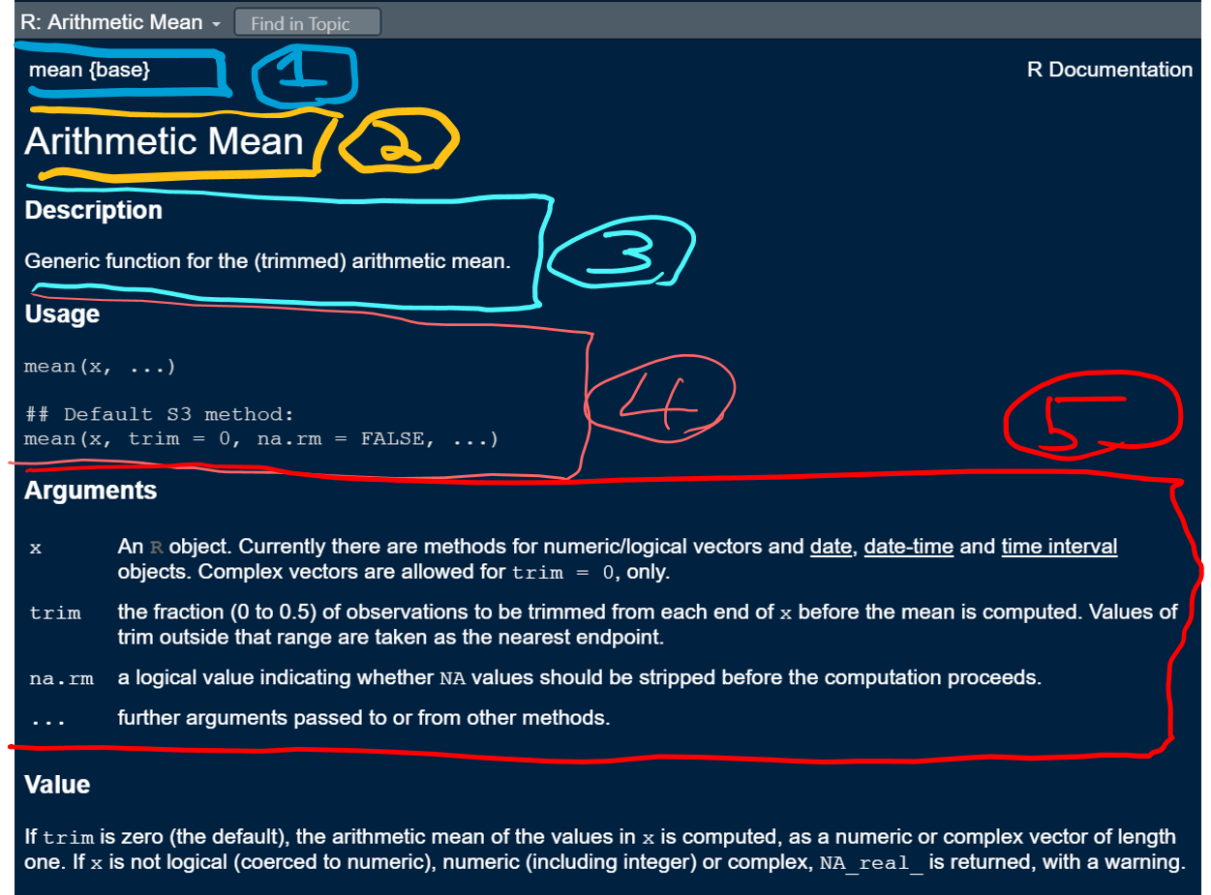
Help
Anatomy of help pages
# Help for mean() help(mean)

Slide 11
Pseudocode
Tell it to the duck!
Break problem down into smaller chunks
Helps with understanding
Give example

Slide 12
Math operators
R math “syntax” works like any calculator
+, -, *, /, ^, etc.
# Add with "+" 2 + 5 # Subtract with "-" 10 - 15

Slide 13
Order of operation
# Try this 4 + 2 * 3 # Order control - same 4 + (2 * 3) # Order control - different... (4 + 2) * 3

Slide 14
Use of spaces
Spaces don’t matter, but style…
# Try this 6+10 # no spaces 7 -5 # uneven spaces 1.6 / 2.3 # large spaces 16 * 3 # exactly 1 space # exactly 1 space probably best...

Slide 15
Logical Boolean operators
TRUE and FALSE
# Try this 3 > 5 # True, yes? # 3 is compared to each element 3 < c(1, 2, 3, 4, 5, 6)

Slide 16
Logical Boolean operators
Useful booleans
# Try this x <- c(21, 3, 5, 6, 22) x x[x > 20]

Slide 17
Regarding “base R” and Tidyverse
"R is rapidly devolving into two mutually unintelligible dialects..."
"I, as a seasoned R programmer, cannot read Tidy code..."
Base R versus Tidyverse (Norm Matloff)
Each has merits
Existence of both makes Googling help harder

Slide 18
Practice Exercises

