Slide 1
Beginning Python for applied Scientists
(and other interesting people)
Ed Harris
HARUG!
2023-08-02

Slide 3
"I ain't gonna learn it! I ain't never gonna use it! Why should I?"
-Skills to understand EVIDENCE, for CPD or merely to be an effective citizen
-Employability, transferrable skills
-Reproducible data >> information is best practice in all evidence-based professions
-Computing 'haves' and 'have-nots'

Slide 4
You will never use math or computing in your career, not in a million billion years

Slide 5
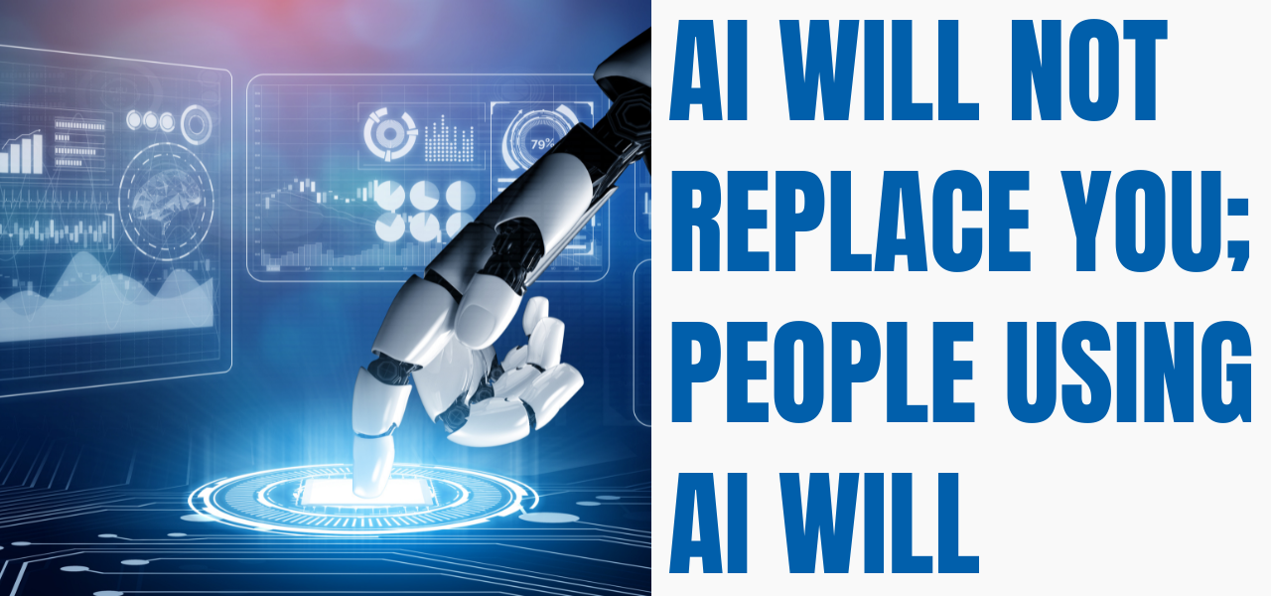
Replace "AI" with programming, statistics and the ability to use computers as a tool rather than merely using them as a helpless thrall

Slide 6
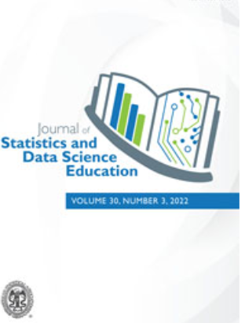
Teaching the programmatic practice of statistics is
widely viewed as best practice and is
implemented in many applied fields and institutions
Statisticians teaching non-statisticians
Applied sciences

Slide 7
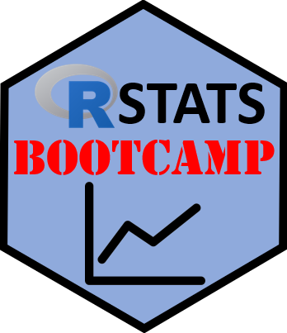
Reflection on the R Stats Bootcamp
(https://rstats-bootcamp.github.io/website/)
Intention:
-Completely open resource
-Help people start learning R
-Self-guided
-"Tutorial" style (Read + run code + problems)

Slide 8
Reflection on the R Stats Bootcamp
(https://rstats-bootcamp.github.io/website/)
What worked?
- Good uptake by many students (MSc, PhD + colleagues)
- "Standing resource" - easy to maintain, examples
- Enables colleagues to teach (and CPD) with 'tame material'

Slide 9
Reflection on the R Stats Bootcamp
(https://rstats-bootcamp.github.io/website/)
Challenges
- Some students do not engage
- 'Handling time' of tutorials
- Course, versus reference + internet

Slide 10
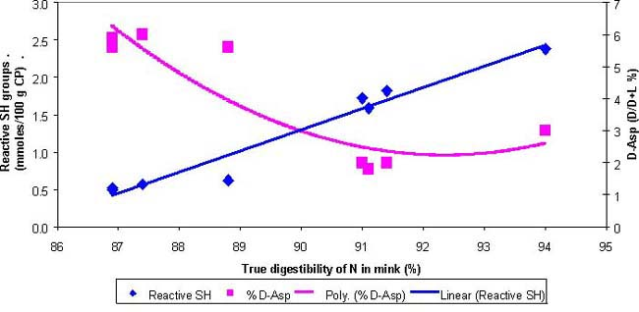
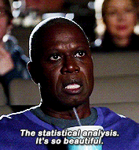
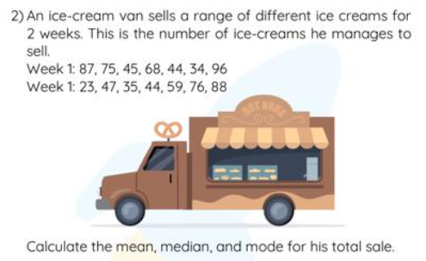
Statistician's dilemma
(folks, it's hard)
What we want to show students day 1
What we actually show students day 1, 2, etc

Slide 11
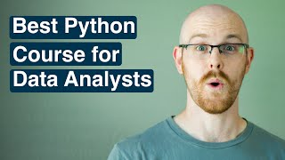
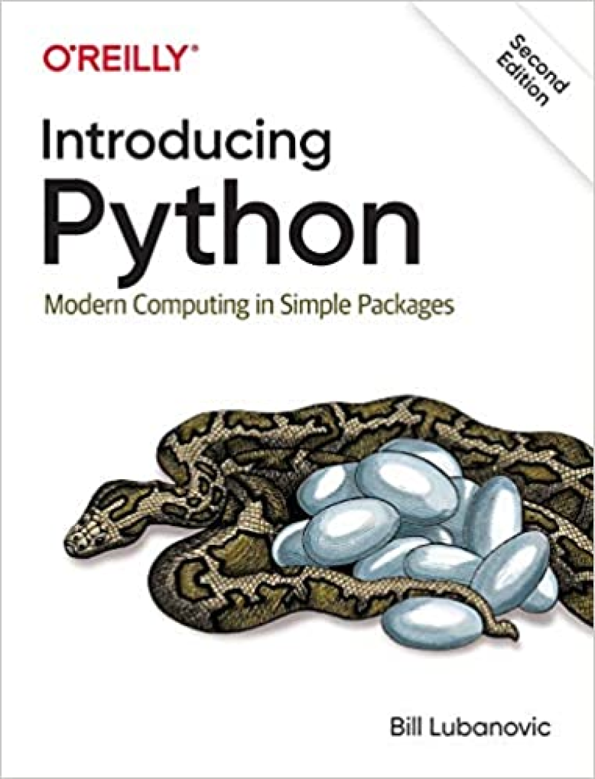
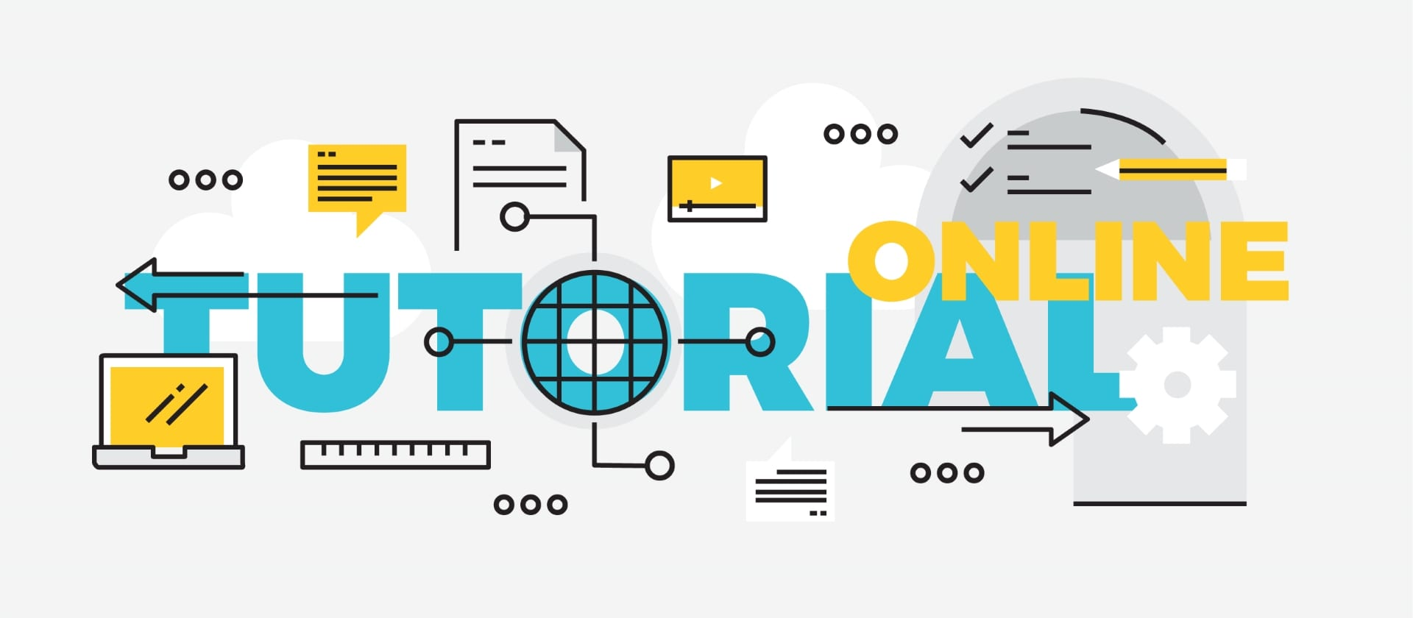
Learning modalities
Traditional module
Online course (e.g. Coursera, EdX)
Textbook
Web-based material
Learn on your own data

Slide 12
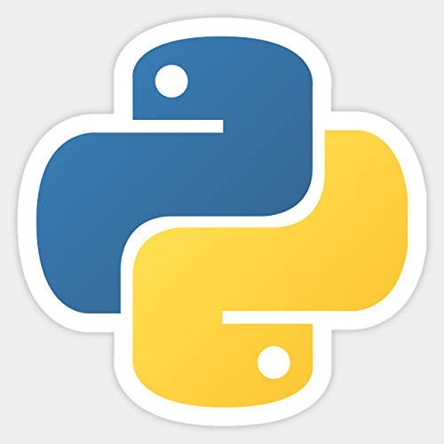
You may want both, but
Best at:
general computing-
AI-
computer vision-
automation-
big data-
Best at:
-statistics
-graphing data
-science stuff
-community
-beginners

Slide 13
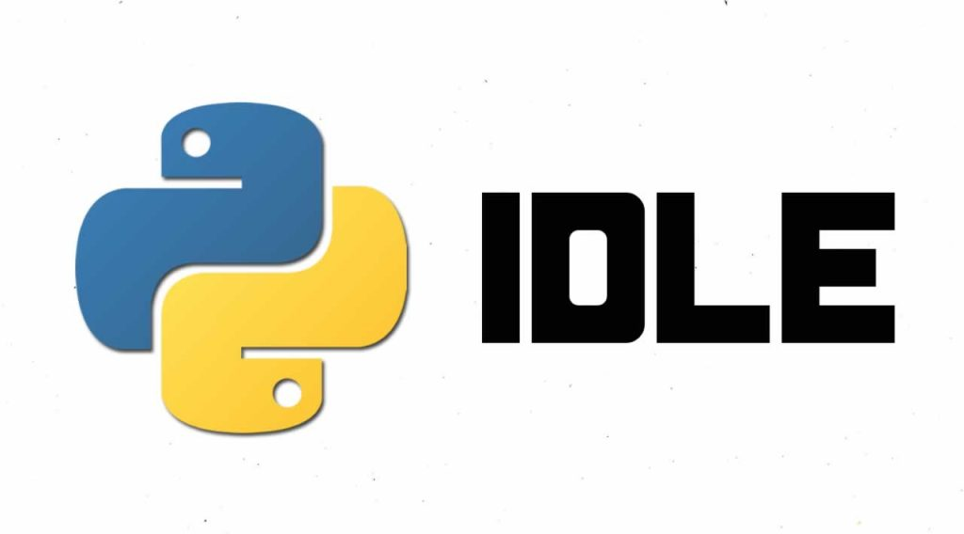
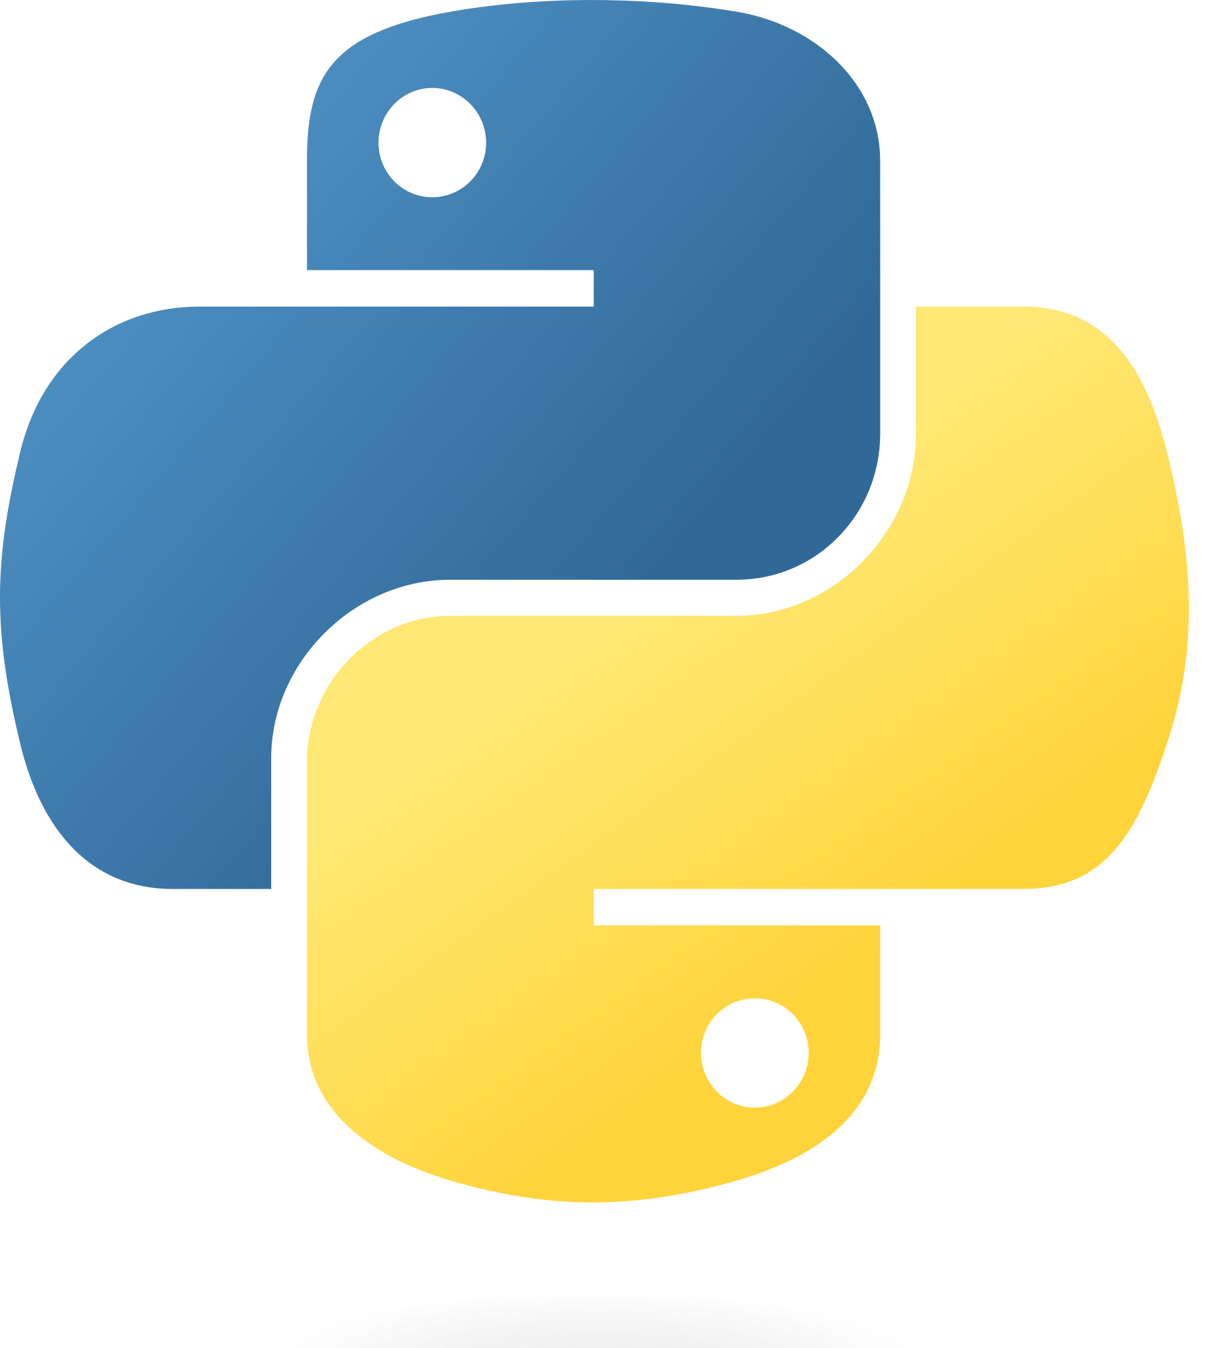
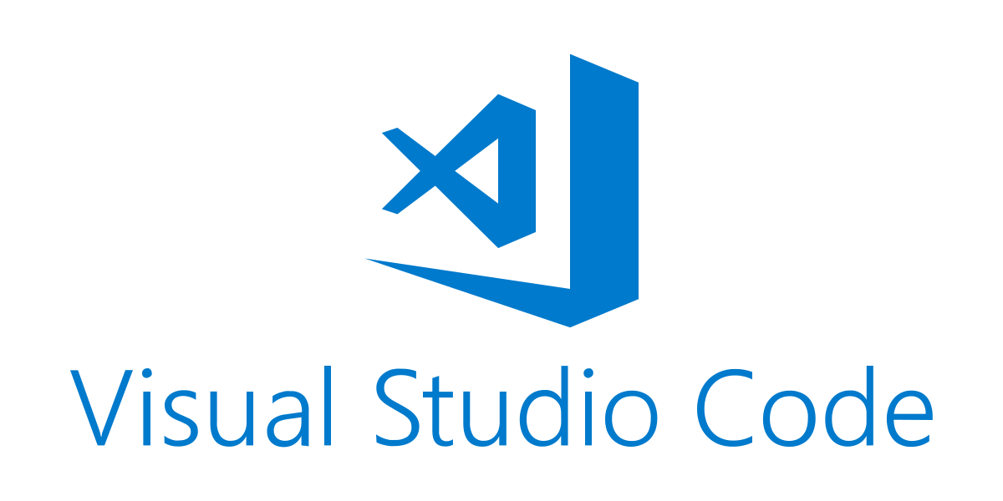
Different ways to use Python
Install Python alone
+ a code editor
Install Anaconda and let it keep track of python and other tools
Install nothing, use Google Colab

Slide 14
Today (a brain-dump vision for a Python Bootcamp):
Interactive Python + Colab page
Starts with data-driven example
Comprehensive list of further Python learning resources
Exercises
ChatGPT…

Slide 15
To Colab…

