Slide 1
Large Language Models, ChatGPT, OpenGPT and LangChain: An overview and what you can do right now
Ed Harris
HARUG!
2023-05-17

Slide 2
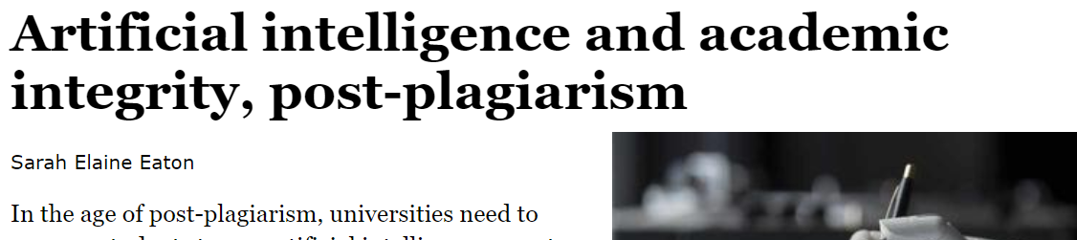
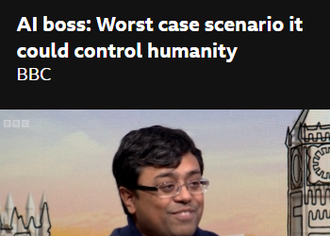
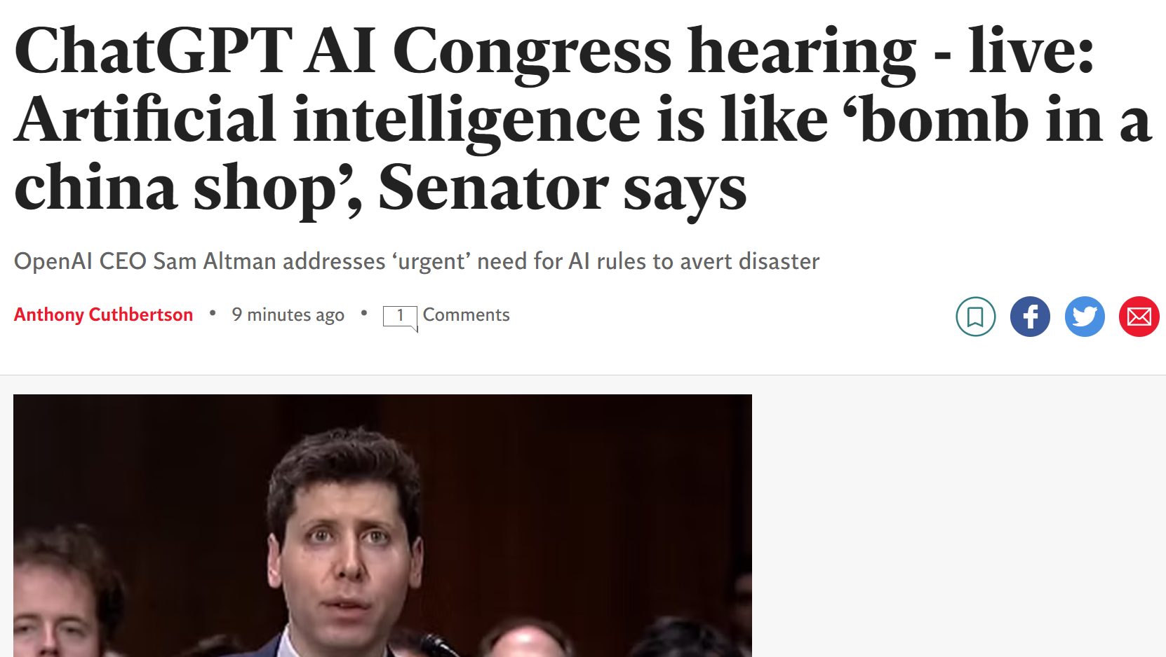
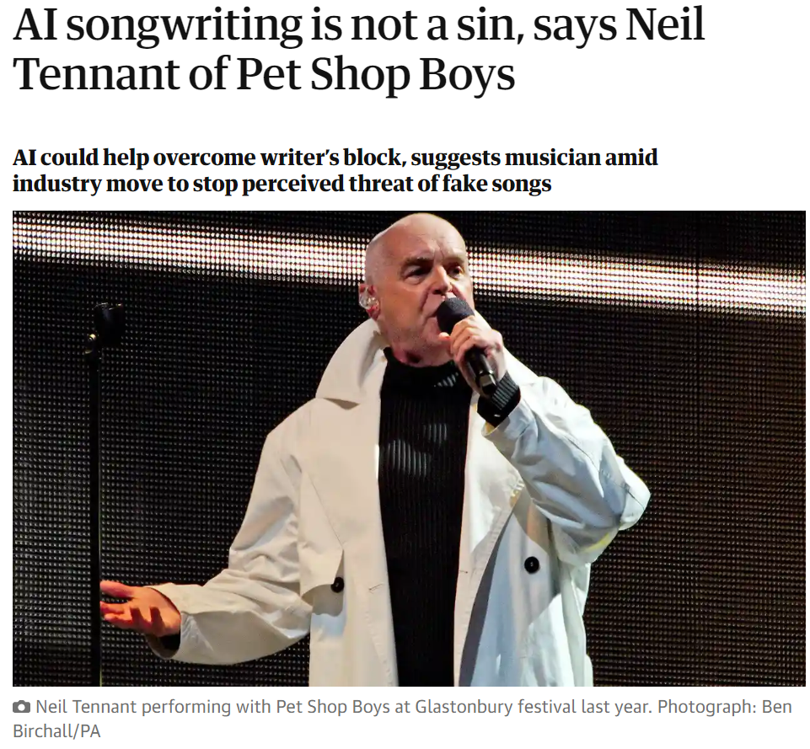
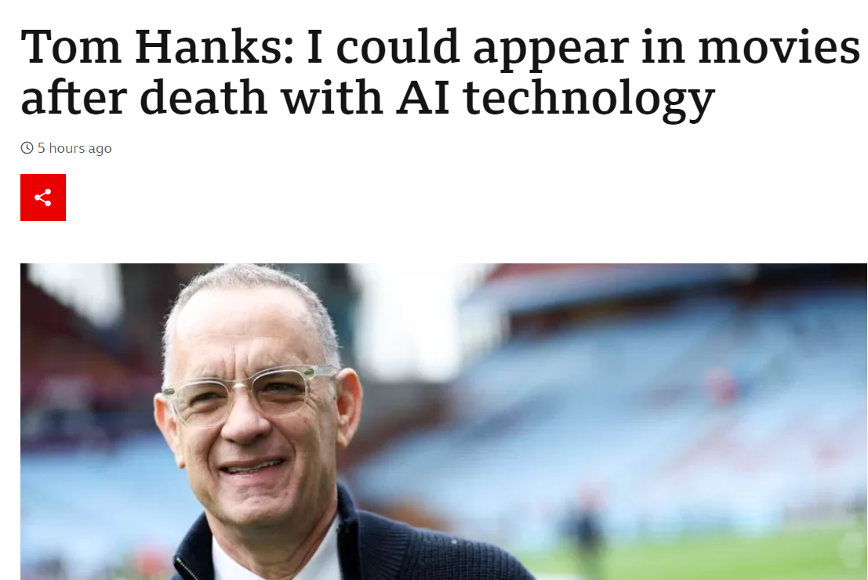
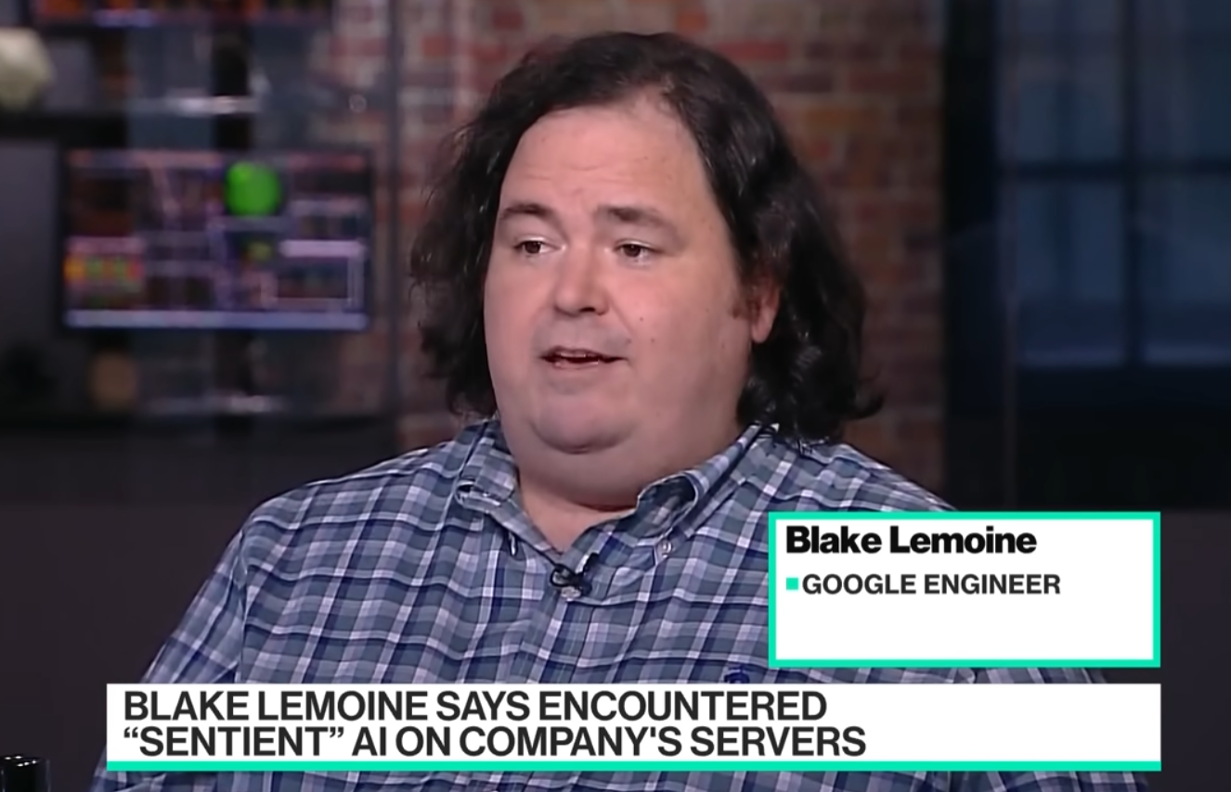
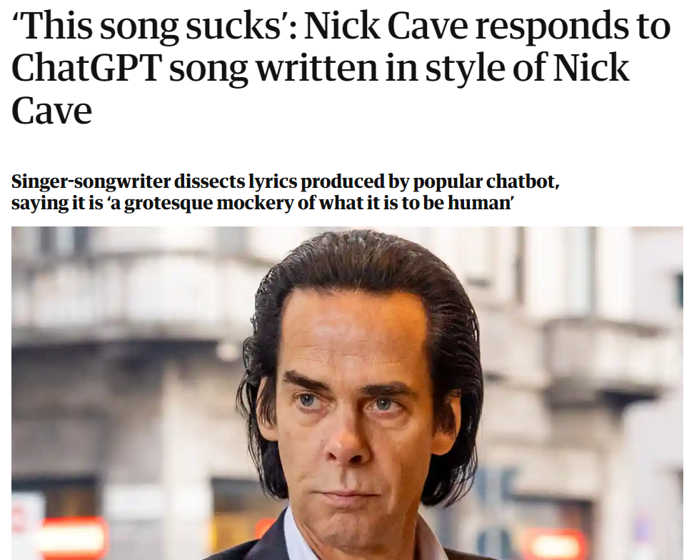
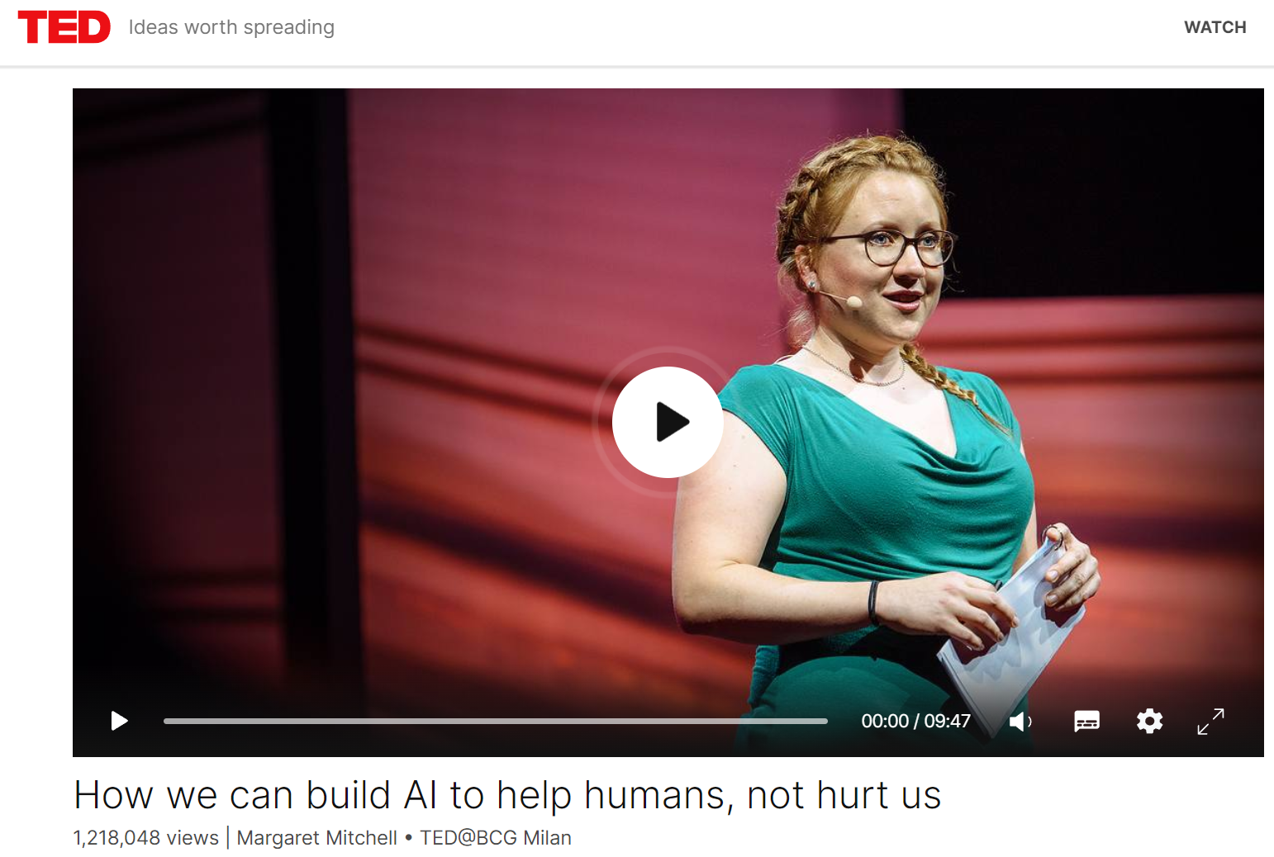

Slide 3
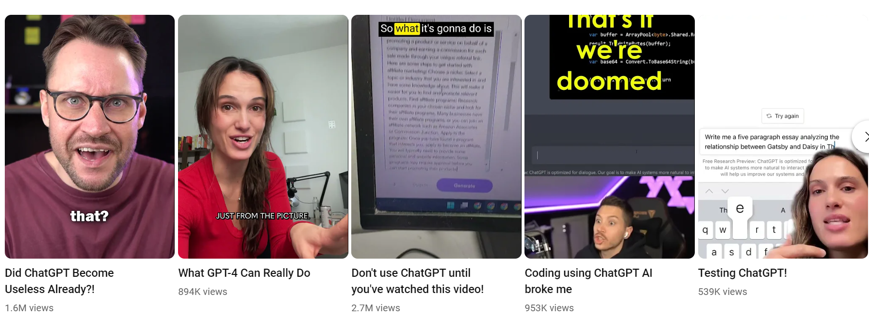
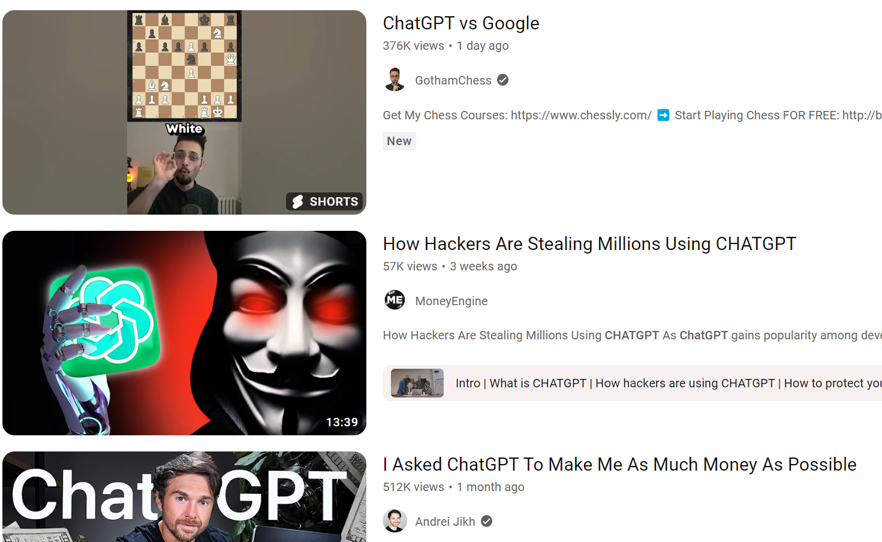

Slide 4
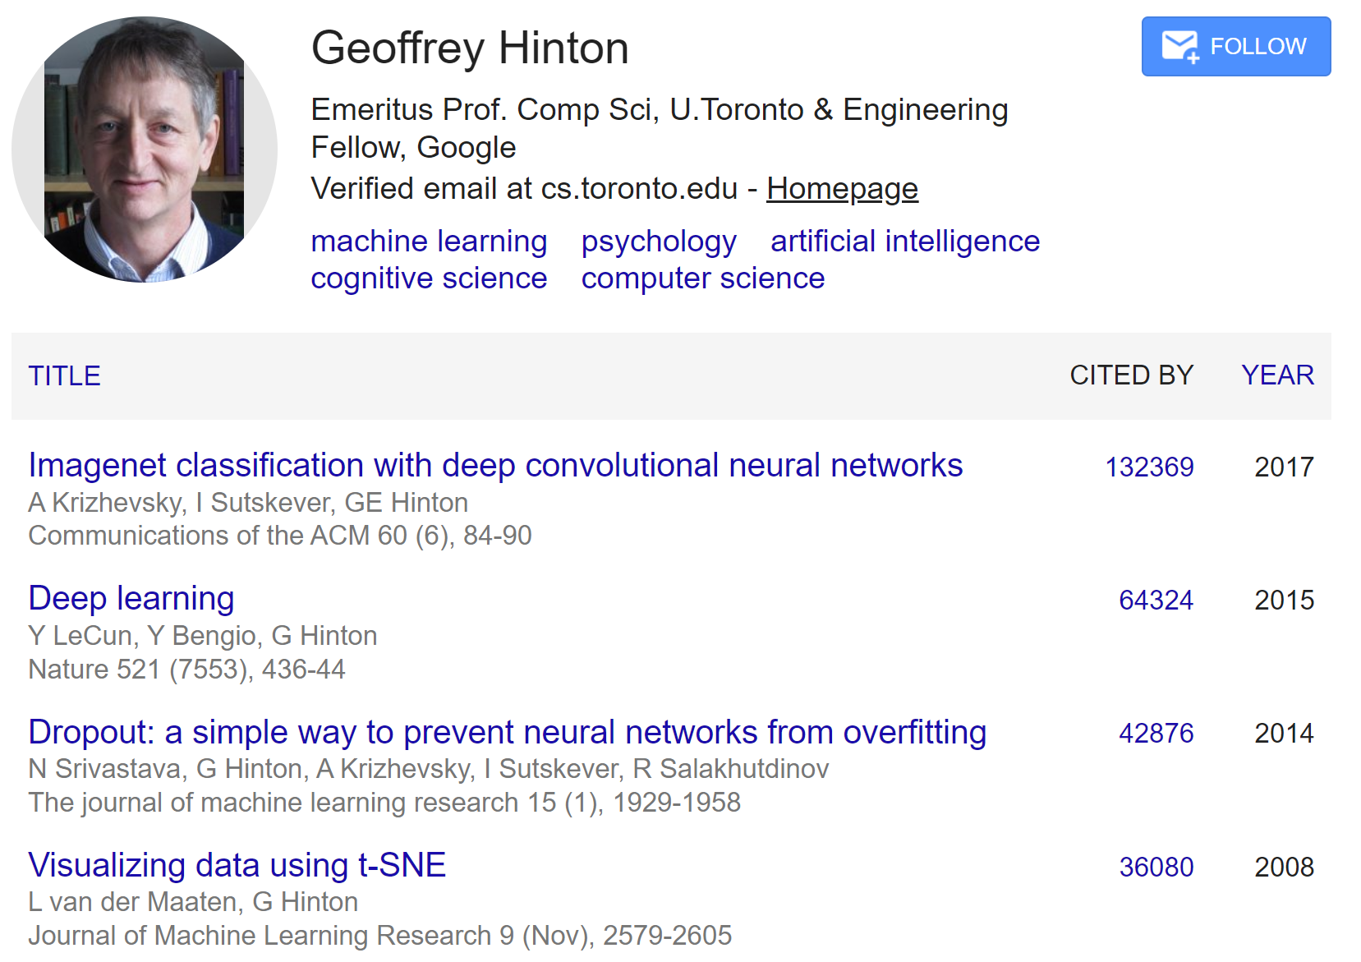
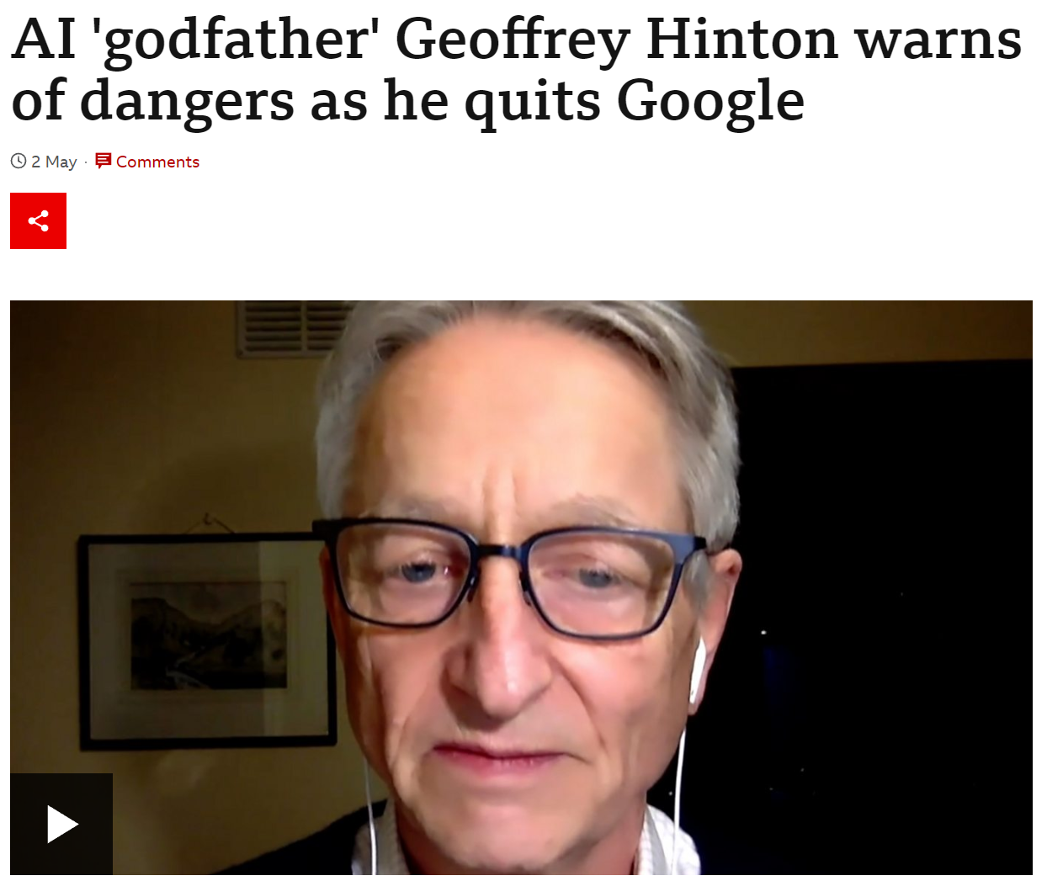

Slide 5
Definitions
Artificial Intelligence (AI)
Large Language Models (LLMs)
OpenAI
ChatGPT (GPT-3.5, GPT-4, etc.)
Prompt engineering
Tokens
GPT
AGI
API

Slide 6
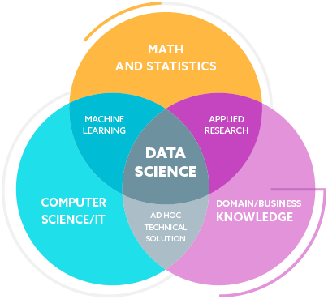
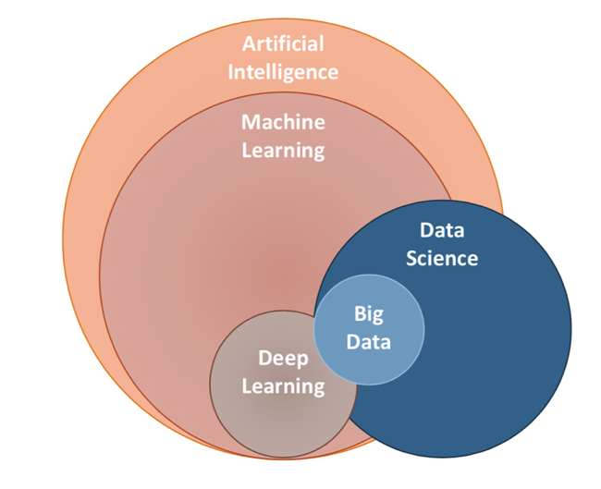
Large Language Models

Slide 7
Free ChatGPT “playground”
https://platform.openai.com/playground
OpenAI GPT-4
https://chat.openai.com/?model=gpt-4
Google Bard
https://bard.google.com/

Slide 8
LLM | Company | Size | Tasks | Stars
(Chat)GPT-4 | OpenAI | 100T (3.5 == 175B) | Chatting, generating text, and translating languages | 5
Bard | Google AI | 137B parameters | Chatting, generating text, translating languages, and answering questions | 4.5
Jurassic-1 Jumbo | Google AI | 1.75T parameters | Chatting, generating text, translating languages, answering questions, and writing different kinds of creative content | 5
Megatron-Turing NLG | Google AI | 530B parameters | Chatting, generating text, translating languages, answering questions, and writing different kinds of creative content | 5
WuDao 2.0 | Beijing Academy of Artificial Intelligence | 1.75T parameters | Chatting, generating text, translating languages, answering questions, and writing different kinds of creative content | 5

Slide 9
Some Prompts...

