Slide 1
Part 1: DeepLabCut
Georgina Wager
HARUG 04-05-2023
a software package for animal pose estimation

Slide 2
DeepLabCut
What problem is it trying to solve?
How does it solve that problem?
Nath, T., Mathis, A., Chen, A.C., Patel, A., Bethge, M. and Mathis, M.W., 2019. Using DeepLabCut for 3D markerless pose estimation across species and behaviors. Nature protocols, 14(7), pp.2152-2176.
Notes:
Different to the standard 2D image detection and classification problem as it is looking to understand movement of the parts within an “object” not just the object itself
Identifies body parts first (with pose estimation) from labelled data, then uses RESNET which is a multi layer deep learning algorithm

Slide 3
DeepLabCut: Applications
What does it do?
extracts user-defined, key body part locations from animals (including humans)
tracking mice in open-field behaviors,
pose-estimation in human babies,
3D-locomotion studies in rodents,

Slide 4
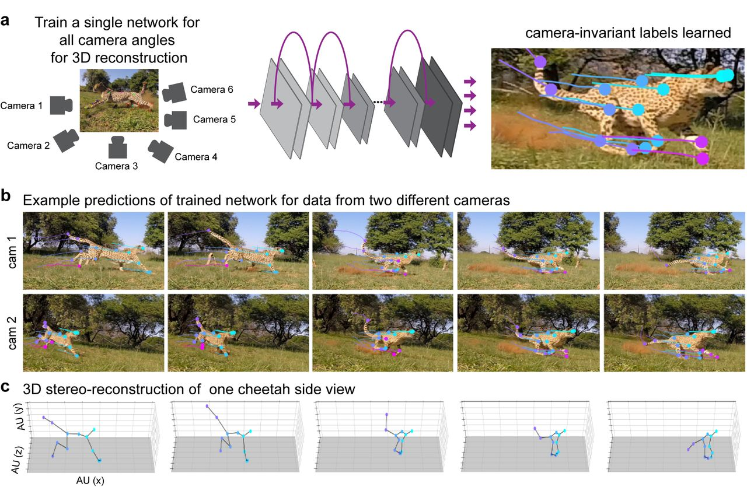
Notes:
where the experimenters wanted to quantitatively track the 3D kinematics of a cheetah performing a high-speed pursuit task as would be done during hunting in the wild

Slide 5
DeepLabCut: Workflow
opening a python session,
importing deeplabcut,
creating a project,
selecting frames,
labeling frames,
then training a network.

Slide 6
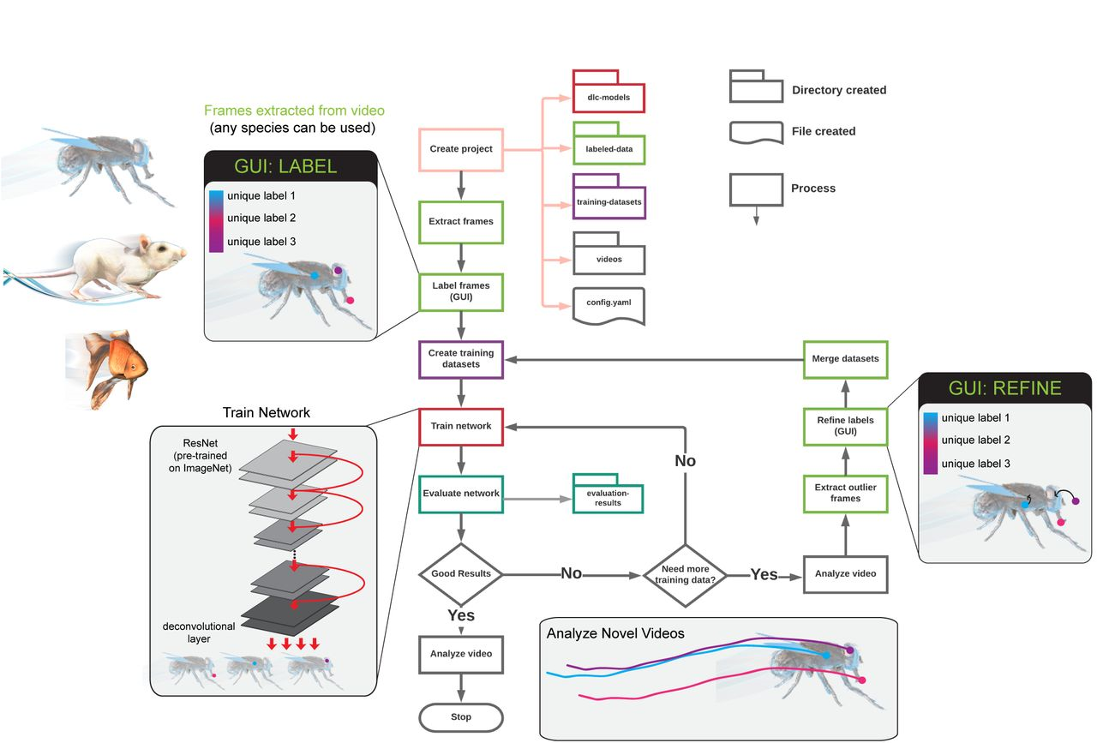

Slide 8
DeepLabCut: Install Options
Option 1: use a system-wide approach – this way overwrites current installations on your machine
Option 2: conda environment based installation (recommended)
Option 3: the supplied Docker container

Slide 9
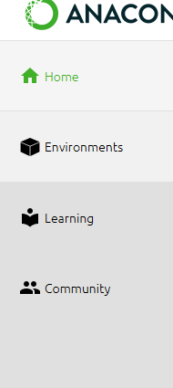
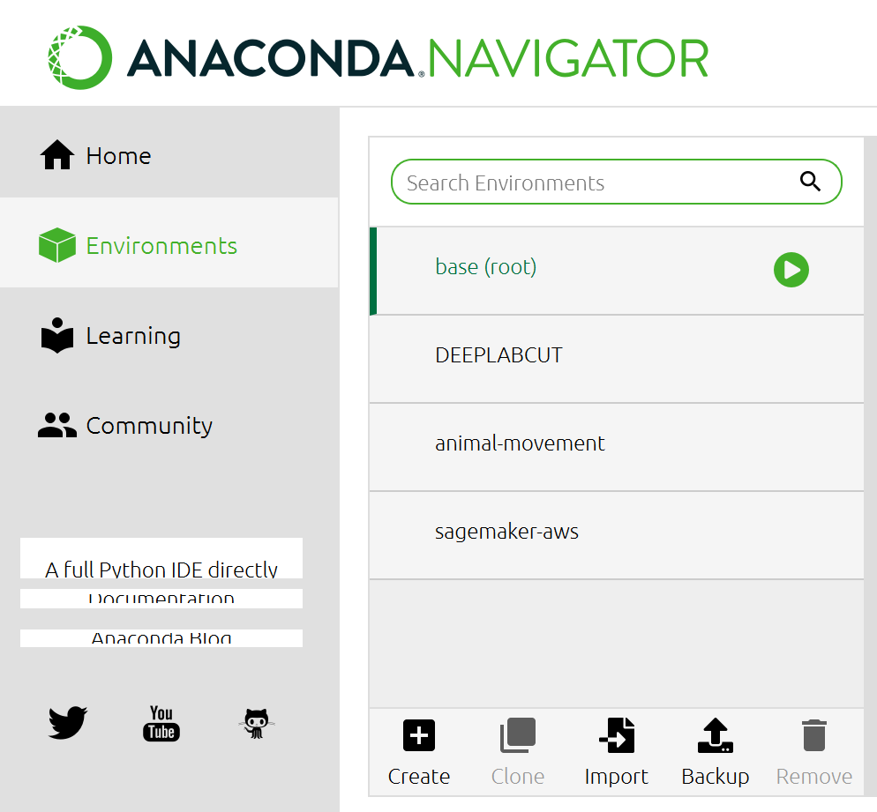
Step 1: Install anaconda
Notes:
Install anaconda by clicking on the link
Open anaconda once installed
On the right hand side, you will see a bar that lists home, environments and other bits
You need to click on environments
Then click Create (this will create a new environment for you)
Name your new environment anything but “deepcutlab” or “DEEPCUTLAB”

Slide 10
Step 2: Git clone the package into your c drive
Like all the good things in life – it has a git
https://github.com/DeepLabCut/DeepLabCut.git
Notes:
You can locate your c-drive within your windows explorer/folders
Then in the location bar (circled in red) remove the path and write “cmd” followed by enter
Then paste and run “git clone https://github.com/DeepLabCut/DeepLabCut.git”
This installs a folder into your c drive called “DeepLabCut”

Slide 11
Step 3: Setting up your Conda Environment
Open up the command prompt from your new anaconda environment
Change your directory into the location of the “conda-environments” for me this looked like this “cd C:\DeepLabCutv01\conda-environments”
Now we need to make the anaconda environment unique for what we need it for “conda env create –f DEEPLABCUT.yaml” (note this takes some time)

Slide 12
Step 4:Acessing your deepcutlab installation
Open up the command prompt from your new anaconda environment
Now activate your new environment “activate deeplabcut”
Open up the deeplabcut software “python -m deeplabcut”

Slide 13
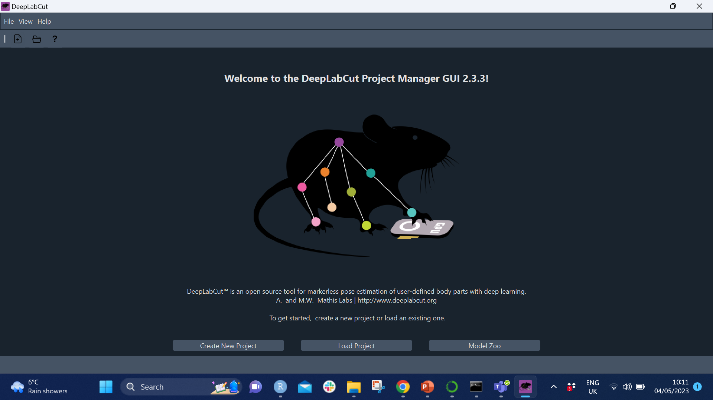
Step 5: Have a play

Slide 14
Part 2: DeepLabCut
Georgina Wager
HARUG 04-12-2023
a software package for animal pose estimation

Slide 15
Purpose of DeepLabCut
To understand behaviors neuroscientists used predetermined markers
These markers were invasive and time consuming
This gave rise to DeepLabCut whereby you could use markerless pose estimation based on transfer learning with deep neural networks
To understand neural networks – watch this vid
transfer learning – using info from an already built model, and transferring it to solve your own problem

Slide 16
DeepLabCut: Workflow
opening a python session,
importing deeplabcut,
creating a project,
selecting frames,
labeling frames,
then training a network.

Slide 18
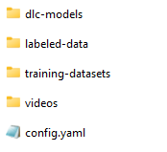
4. Selecting frames
Once your project is created you have the following folders and file
The next step consists of sampling all frames from all the videos in your project and then selecting only a small subsample of frames from each video to be labeled manually.
You can do this in the GUI under the “extract frames tabs”
Here is where the sub sample of frames go for labelling
Here is where all the videos go
Here is where you put the body parts and the relationship between body parts

Slide 21
5. Labeling frames

Slide 22
6. Training a network
Create training dataset

Slide 23
Output
1 x csv file for each video containing the coordinates and prediction accuracy for each of the markers at each video frame.
To start processing your DeepLabCut output the co ordinates need to be analysed and this can then extract movement, pose or behavior.

Slide 24
Key reads
Mathis, A., Mamidanna, P., Cury, K.M., Abe, T., Murthy, V.N., Mathis, M.W. and Bethge, M., 2018. DeepLabCut: markerless pose estimation of user-defined body parts with deep learning. Nature neuroscience, 21(9), pp.1281-1289.
Nath, T., Mathis, A., Chen, A.C., Patel, A., Bethge, M. and Mathis, M.W., 2019. Using DeepLabCut for 3D markerless pose estimation across species and behaviors. Nature protocols, 14(7), pp.2152-2176.
Kane, G.A., Lopes, G., Saunders, J.L., Mathis, A. and Mathis, M.W., 2020. Real-time, low-latency closed-loop feedback using markerless posture tracking. Elife, 9, p.e61909.
Lauer, J., Zhou, M., Ye, S., Menegas, W., Schneider, S., Nath, T., Rahman, M.M., Di Santo, V., Soberanes, D., Feng, G. and Murthy, V.N., 2022. Multi-animal pose estimation, identification and tracking with DeepLabCut. Nature Methods, 19(4), pp.496-504.

Slide 25
Part 3: DeepLabCut
Georgina Wager
HARUG 04-26-2023
a software package for animal pose estimation

Slide 26
Summary
Step 1: Identify positions in the form of “poses” on a small subset of data (known as the training data)
Step 2: Train the model to identify “poses” on unseen data (known as the test data)
Step 3: Analysis poses to predict behaviors
Notes:
Step one has been done, however step 2 was difficult to carry out with limited access to enough GPU – I had to upgrade the

Slide 29
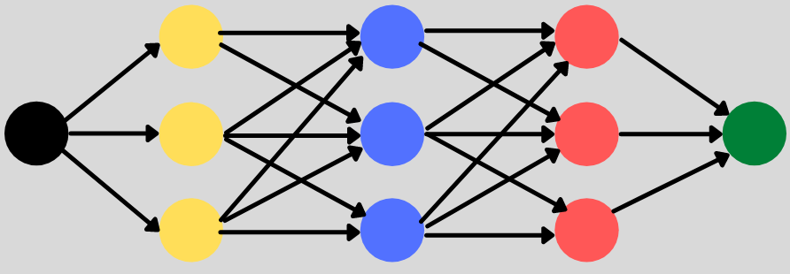
CNN – Convolutional Neural Network
Notes:
Multiple hidden layers and each layer has multiple nodes. Each node in a layer is defined by its weight values.
A CNN, has a convolution layer (at least one) which makes it different to a neural network alone where each layer is a matrix multiplication.
You may not believe this but the first CNN was actually introduced in 1998 “LeNet – 5 Architecture” - for use on the Mnist Data set

Slide 30
Notes:
A Convolutional layer enables a “deeper” feature map, which in turn provides the model with a better understanding of the features within an image
The number and arrangement of the convolutional layer, pooling layer basically determines the “type of CNN” then each different CNN has a different jargon name (etc VGGNet, GoogleLeNet, AlexNet, LeNet 5, Now another one of these is also the “ResNet” – now the Resnet is what is used within the deeplabcut framework)

Slide 31
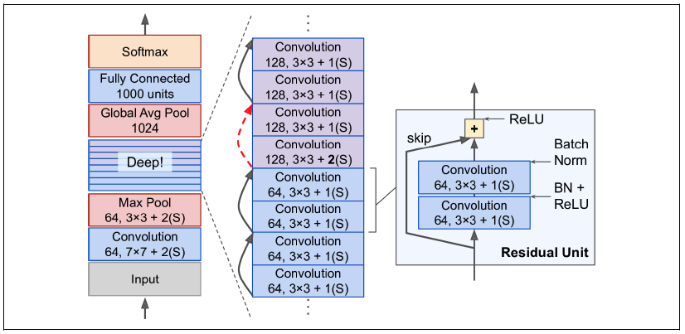
ResNet (Residual Network)
Caries out Residual Learning
Notes:
So in the green is the residual learning part
You can see the skip connection, and what that means is that the information/signal finding into a layer also feeds into the output of a layer higher the model architecture
Each residual unit is a small neural network that contains a skip connection

Slide 32
Analysing the co-ordinates
To extract movement and behaviors

Slide 33
Analysing the co-ordinates
To extract movement and behaviors

Slide 34
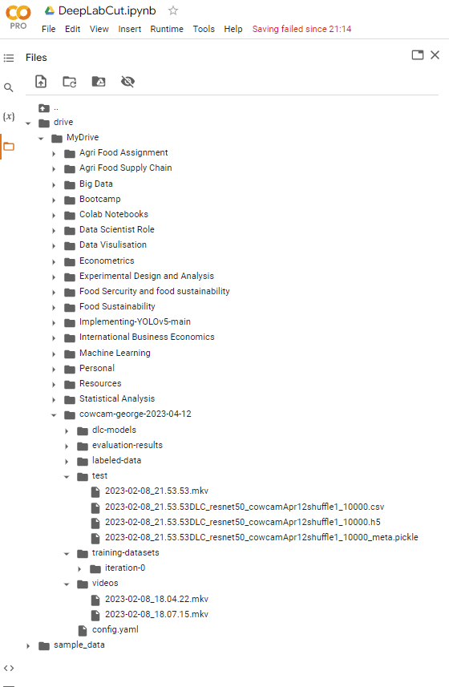
Giving the model a new video - created a new folder called “test” and put in the “unseen video”
Notes:
Then you can plot

Slide 35
“unseen video”

Slide 36
Output co ordinates
Notes:
Outputs a csv file that looks something like this
For each of the points identified there is an x, y and the likelihood of that pose being present there.

Slide 37
“unseen video” - identified points

Slide 38
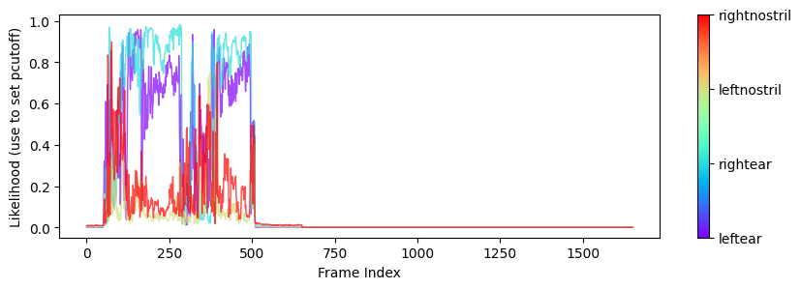
Graph 1
Notes:
likelihoods vs time

Slide 39
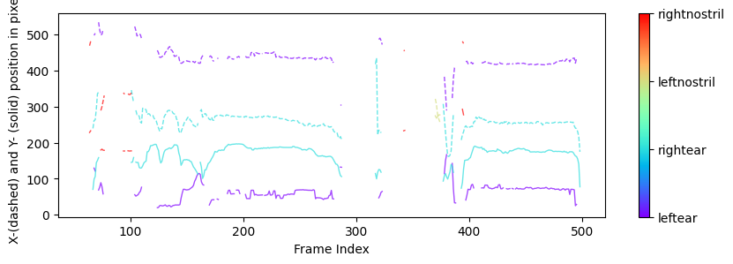
Graph 2
Notes:
The x- vs. y- coordinate position in pixels of the body parts

Slide 40
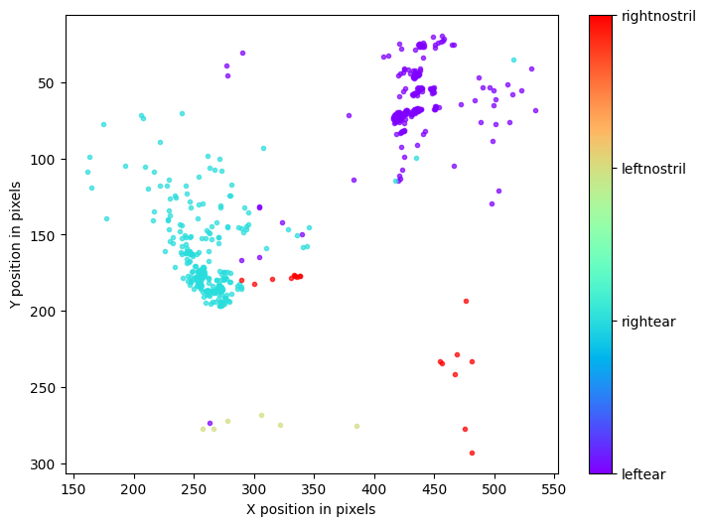
Graph 3

Slide 41
Part 4: DeepLabCut
Georgina Wager
HARUG 05-10-2023
a software package for animal pose estimation

Slide 42
Next steps: Understanding the behaviors
To extract movement, pose or behavior
https://github.com/DeepLabCut/DLCutils
https://europepmc.org/article/PMC/PMC8832219 (paper looking at gait in humans
Links about simba
https://www.biorxiv.org/content/10.1101/2020.04.19.049452v2
https://github.com/sgoldenlab/simba

